Slide 1
Data Dictionary
19SW01
Afsa Riaz

Slide 2
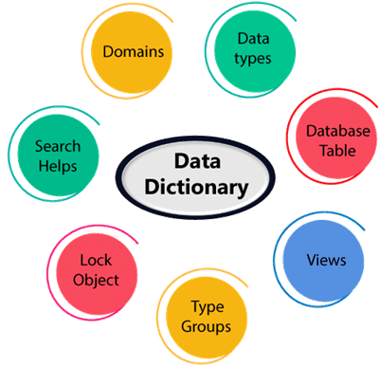
Introduction
A data dictionary contains metadata i.e. data about the database. The data dictionary is very important as it contains information such as what is in the database, who is allowed to access it, where is the database physically stored etc. The users of the database normally don't interact with the data dictionary, it is only handled by the database administrators.

Slide 3
Contents of Data Dictionary
Names of all the database tables and their schemas.
Details about all the tables in the database, such as their owners, their security constraints, when they were created etc.
Physical information about the tables such as where they are stored and how.
Table constraints such as primary key attributes, foreign key information etc.
Information about the database views that are visible.

Slide 4
Example
Field Name | Data Type | Field Size for Display | Description | Example
Employee Number | Integer | 10 | Unique id of each employee | 1645000001
Name | Text | 20 | Name of the employee | David Heston
Date of Birth | Date | 10 | DOB of employee | 11/01/1992
Phone Number | Integer | 11 | Phone Number of employee | 01234567890

Slide 5
Active Data Dictionary
If the structure of the database or its specifications change at any point of time, it should be reflected in the data dictionary. This is the responsibility of the database management system in which the data dictionary resides.
So, the data dictionary is automatically updated by the database management system when any changes are made in the database. This is known as an active data dictionary as it is self updating.

Slide 6
Passive Data Dictionary
This is not as useful or easy to handle as an active data dictionary. A passive data dictionary is maintained separately to the database whose contents are stored in the dictionary. That means that if the database is modified the database dictionary is not automatically updated as in the case of Active Data Dictionary.
So, the passive data dictionary has to be manually updated to match the database. This needs careful handling or else the database and data dictionary are out of sync.

